Slide 2

Introduction
Project Name: Popcorn
Tag line: “Don’t miss a single frame”

Slide 3
Project Summary
The "Movie Ticket Booking Website" project aims to create an online platform for users to conveniently browse, select, and purchase movie tickets and order food in theaters.
This website will feature a user-friendly interface, real-time movie listings, showtimes, seat selection, and secure payment options. It will provide a seamless movie booking experience, enhancing accessibility to cinema entertainment for users.

Slide 4
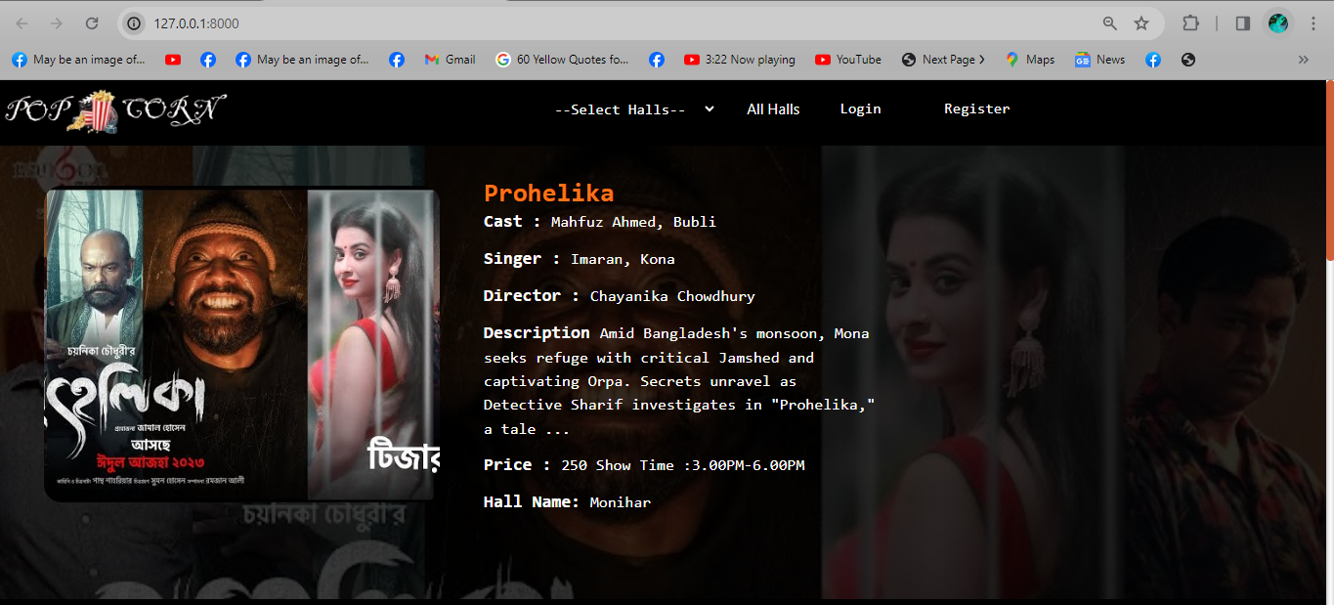
Home Page

Slide 5
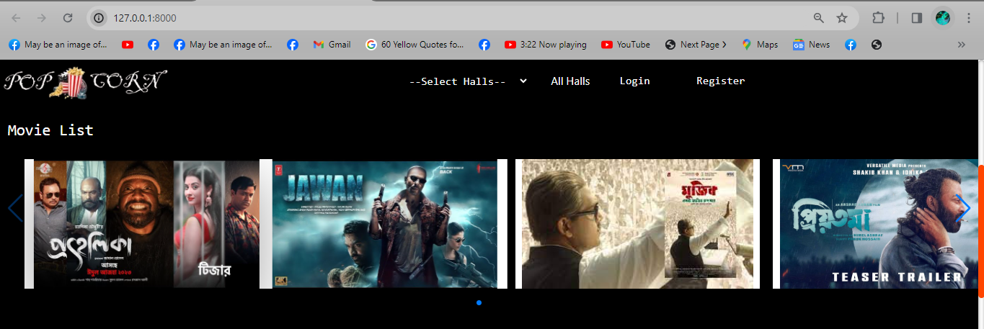
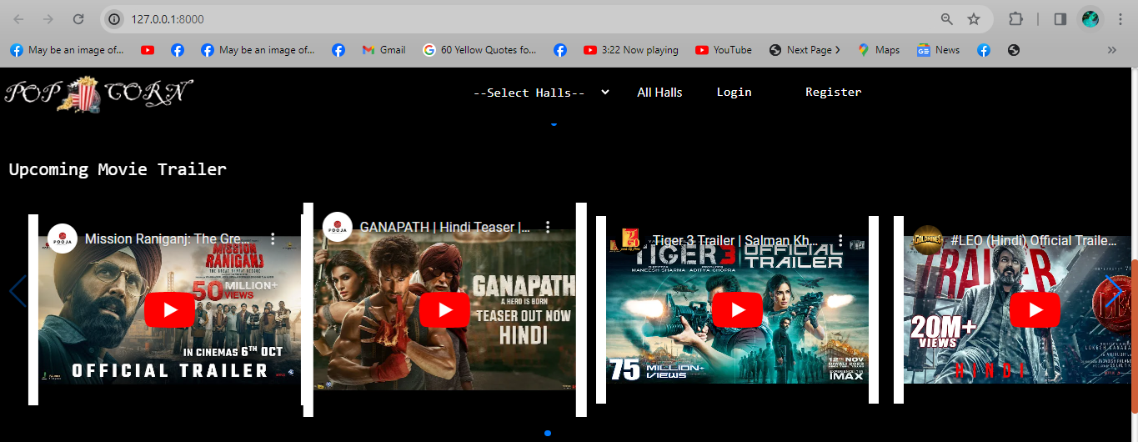
Home Page Continue

Slide 6
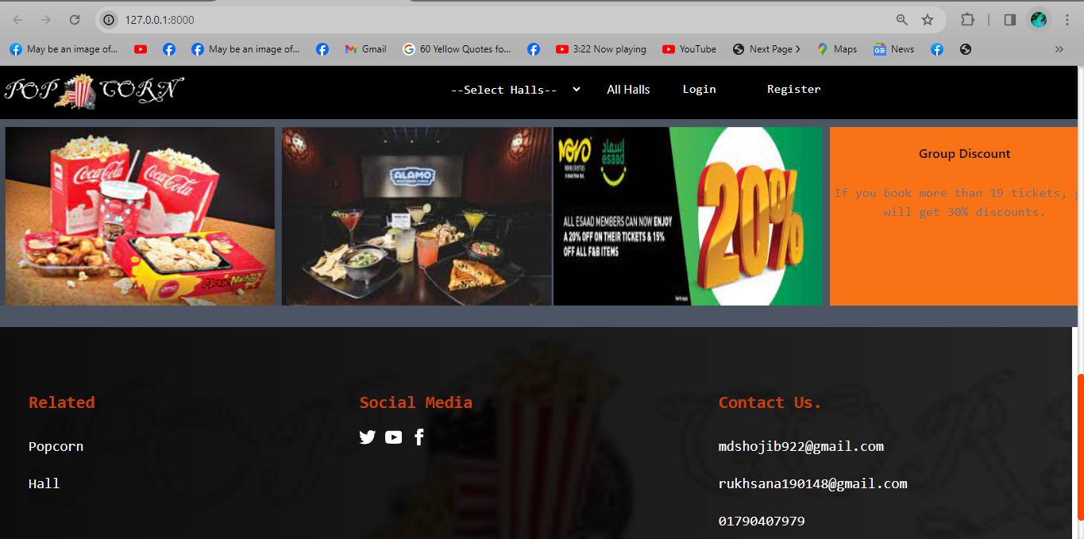
Home Page Continue….!

Slide 7
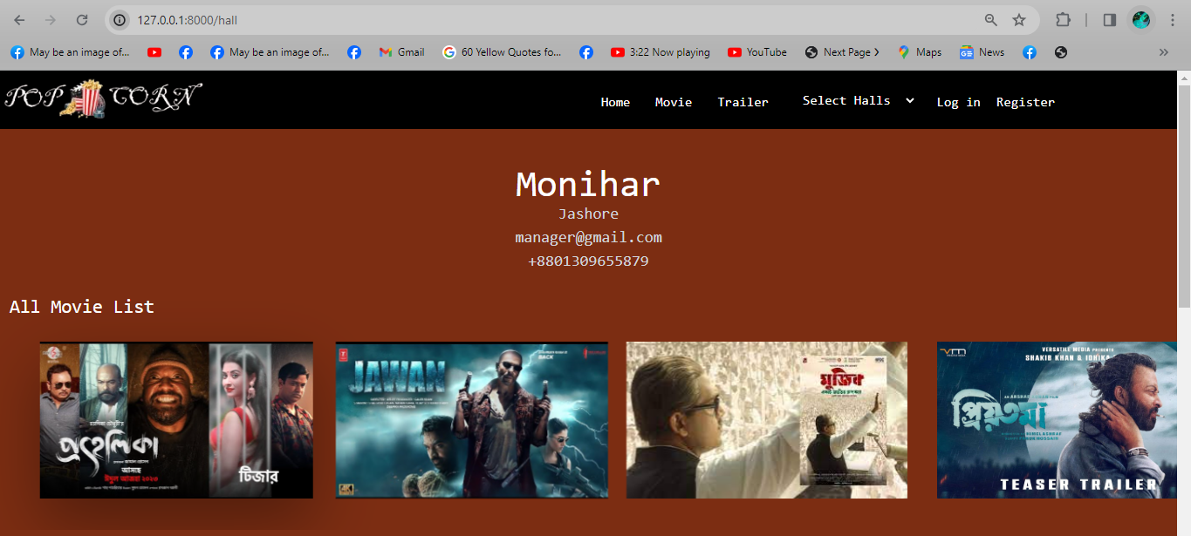
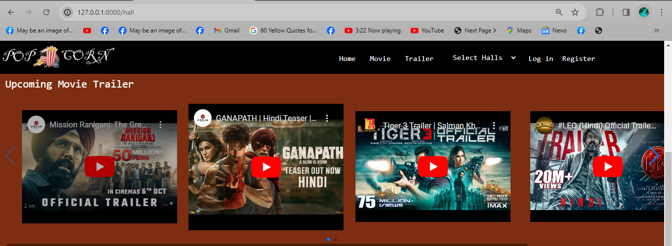
Separate Hall

Slide 8
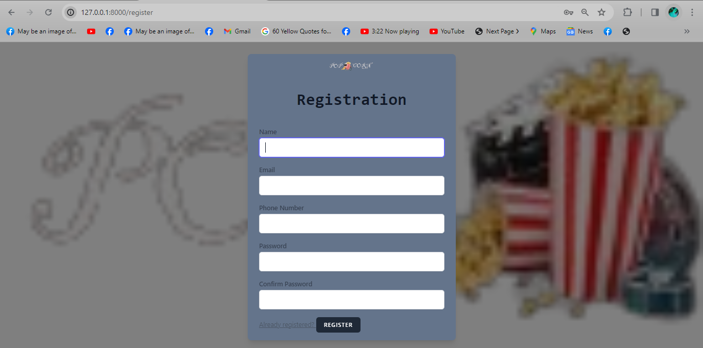
Authentications

Slide 9
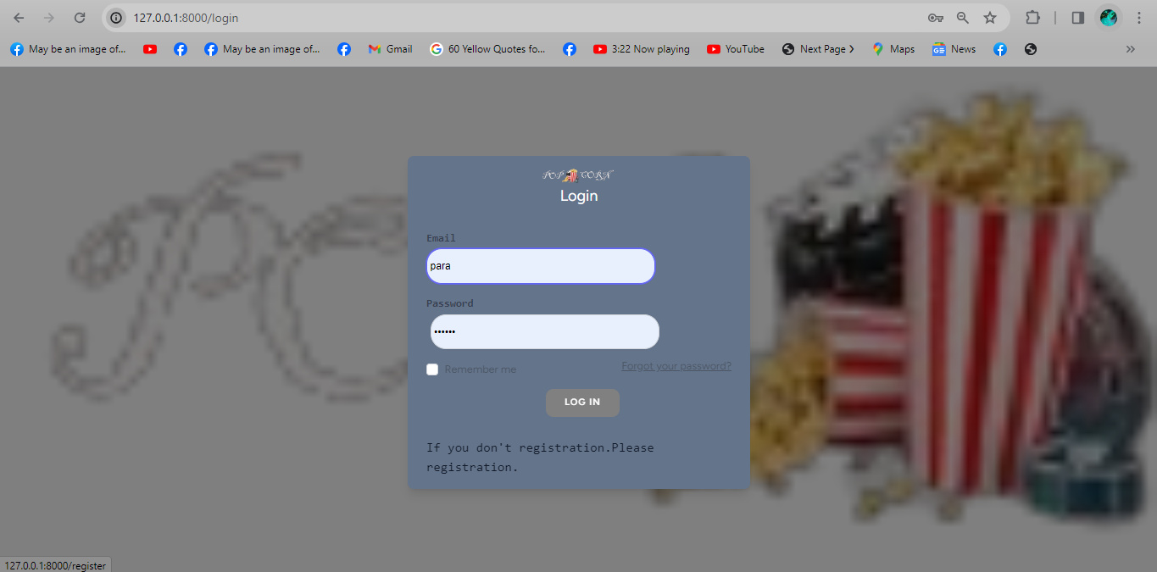
Authentication Continue….!!

Slide 10
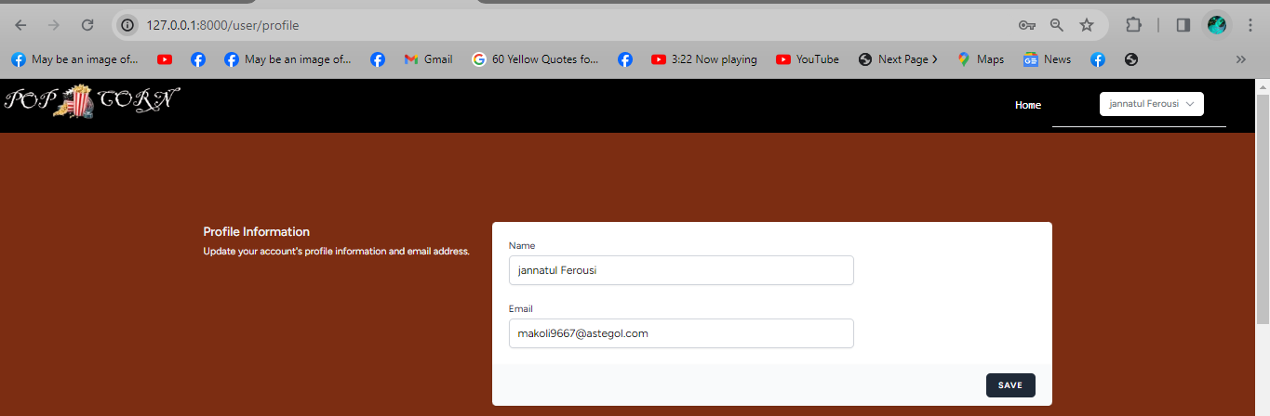
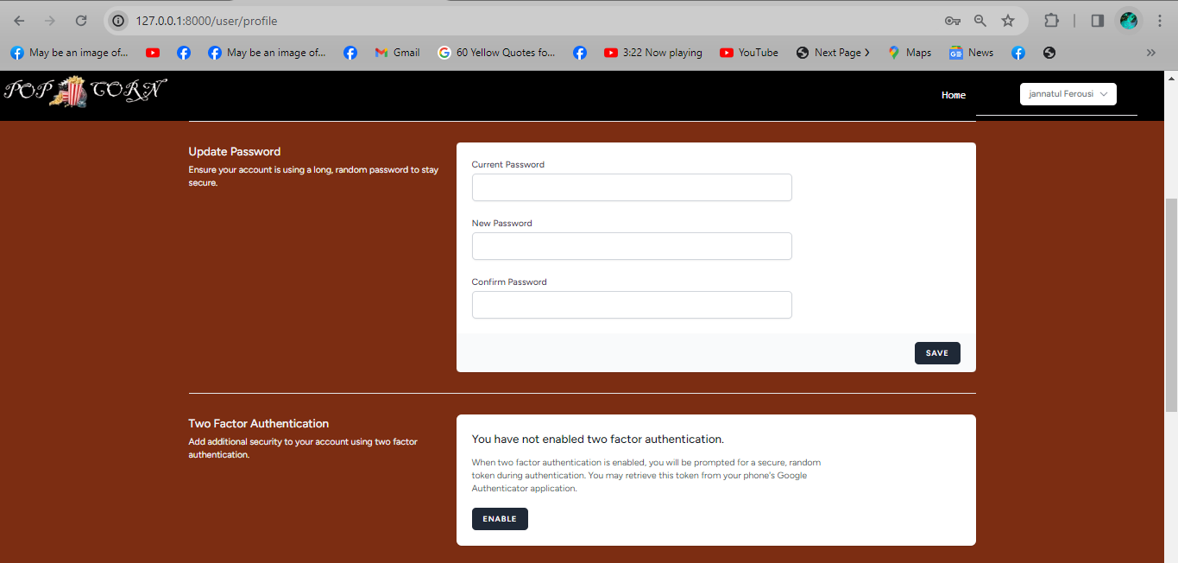
User’s Profile

Slide 11
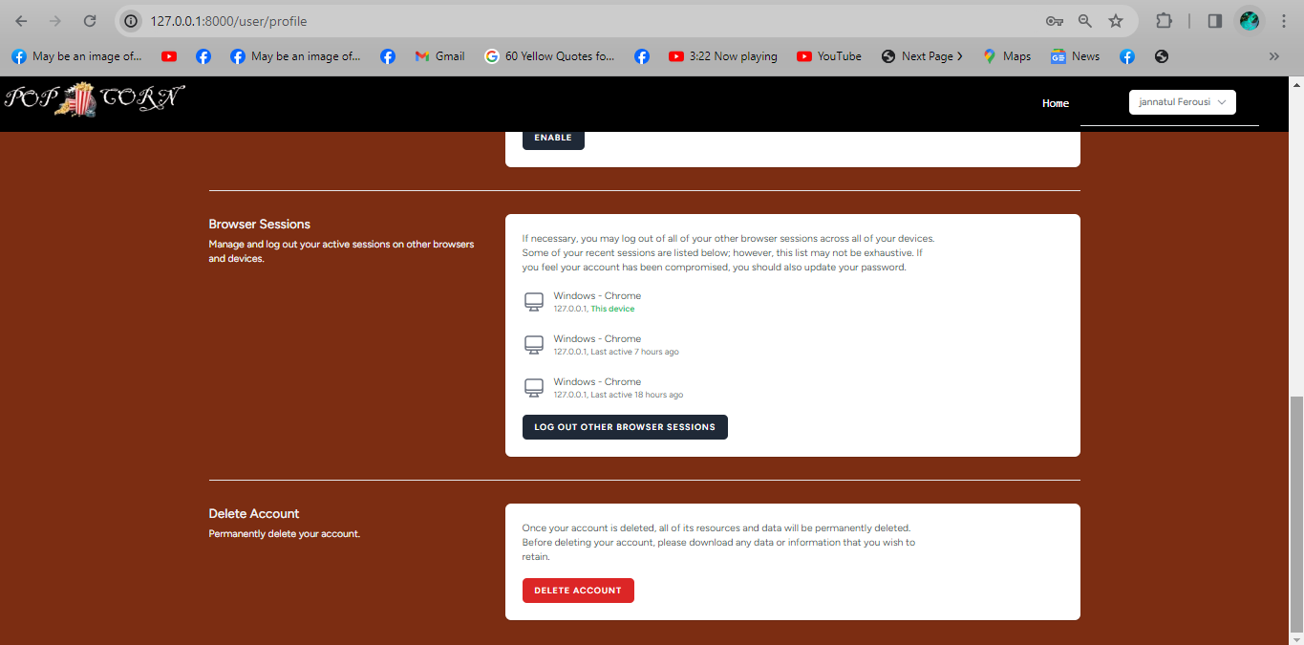
User’s Profile Continue…!
Notes:
Dubai Futures Foundation:
http://gulfnews.com/news/uae/government/huge-global-response-for-dubai-future-accelerators-programme-1.1880339

Slide 12
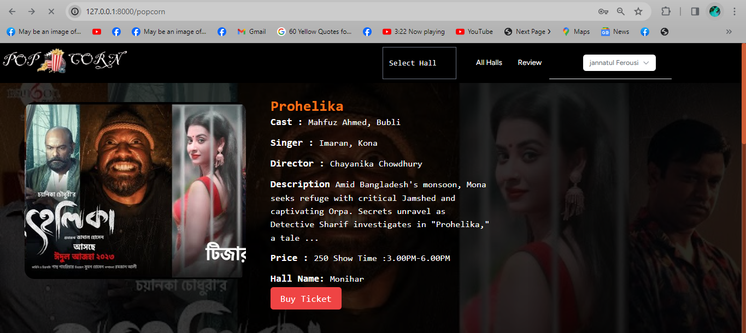
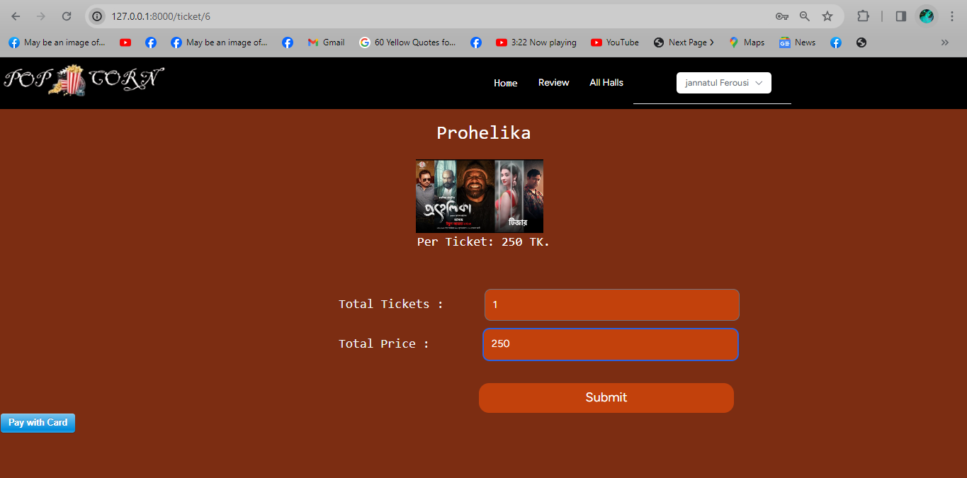
Show Details
Notes:
Dubai Futures Foundation:
http://gulfnews.com/news/uae/government/huge-global-response-for-dubai-future-accelerators-programme-1.1880339

Slide 13
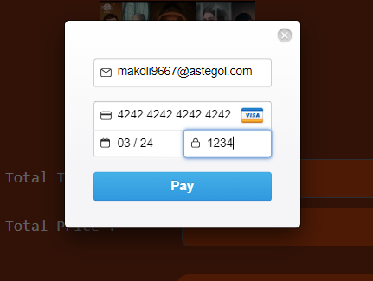
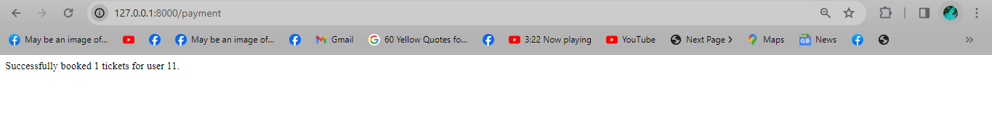
Payment Gateway (Stripe)
Notes:
Dubai Futures Foundation:
http://gulfnews.com/news/uae/government/huge-global-response-for-dubai-future-accelerators-programme-1.1880339

Slide 14
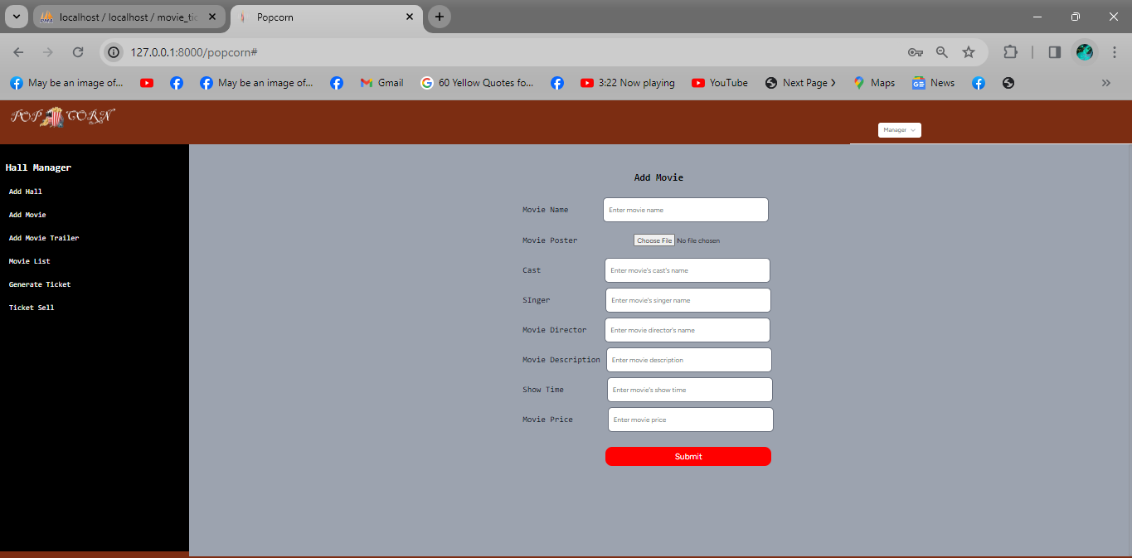
Hall Managers Profile
Notes:
Dubai Futures Foundation:
http://gulfnews.com/news/uae/government/huge-global-response-for-dubai-future-accelerators-programme-1.1880339

Slide 15
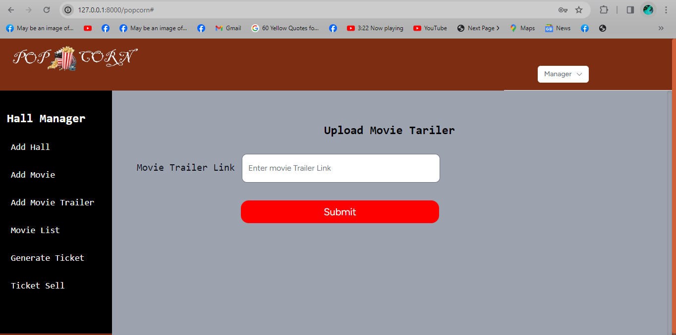
Hall Managers Profile Continue…!
Notes:
Dubai Futures Foundation:
http://gulfnews.com/news/uae/government/huge-global-response-for-dubai-future-accelerators-programme-1.1880339

Slide 16
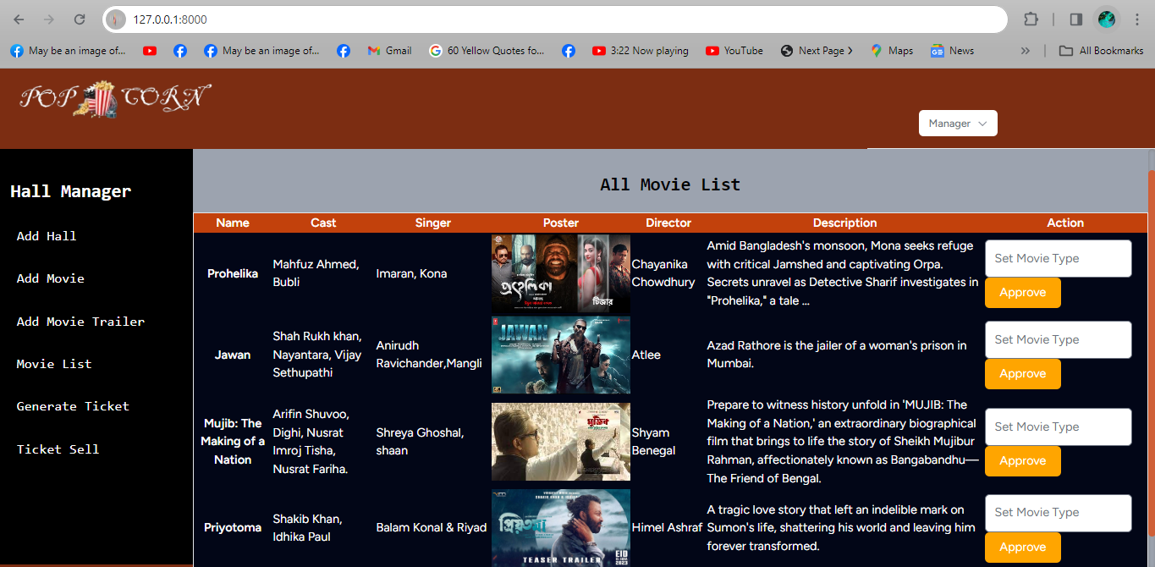
Hall Managers Profile Continue…!!
Notes:
Dubai Futures Foundation:
http://gulfnews.com/news/uae/government/huge-global-response-for-dubai-future-accelerators-programme-1.1880339

Slide 17
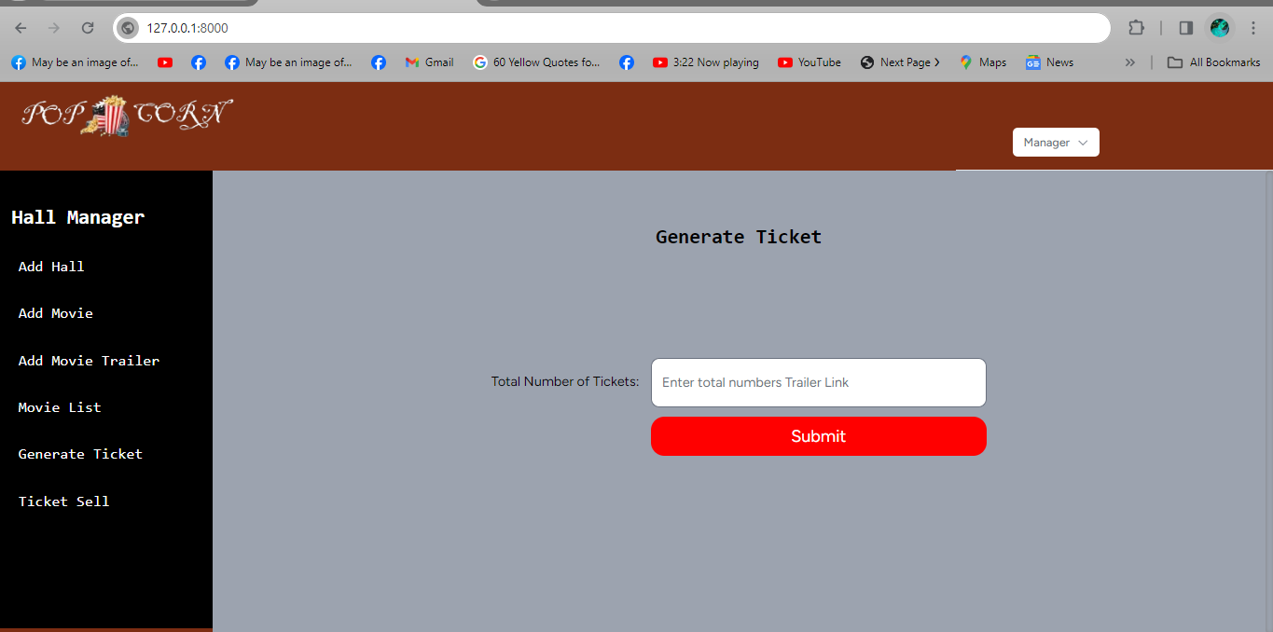
Hall Managers Profile Continue…!!!
Notes:
Dubai Futures Foundation:
http://gulfnews.com/news/uae/government/huge-global-response-for-dubai-future-accelerators-programme-1.1880339

Slide 18
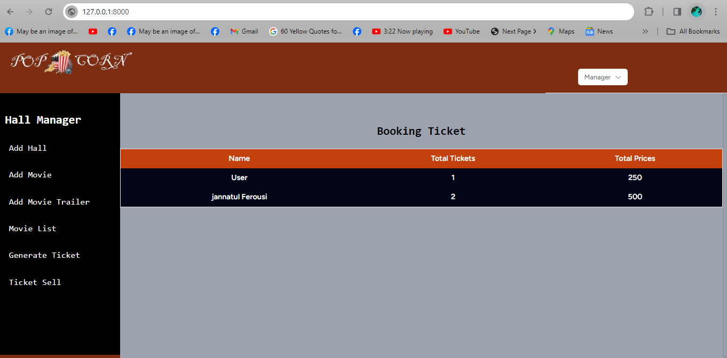
Hall Managers Profile Continue…!V
Notes:
Dubai Futures Foundation:
http://gulfnews.com/news/uae/government/huge-global-response-for-dubai-future-accelerators-programme-1.1880339

Slide 19
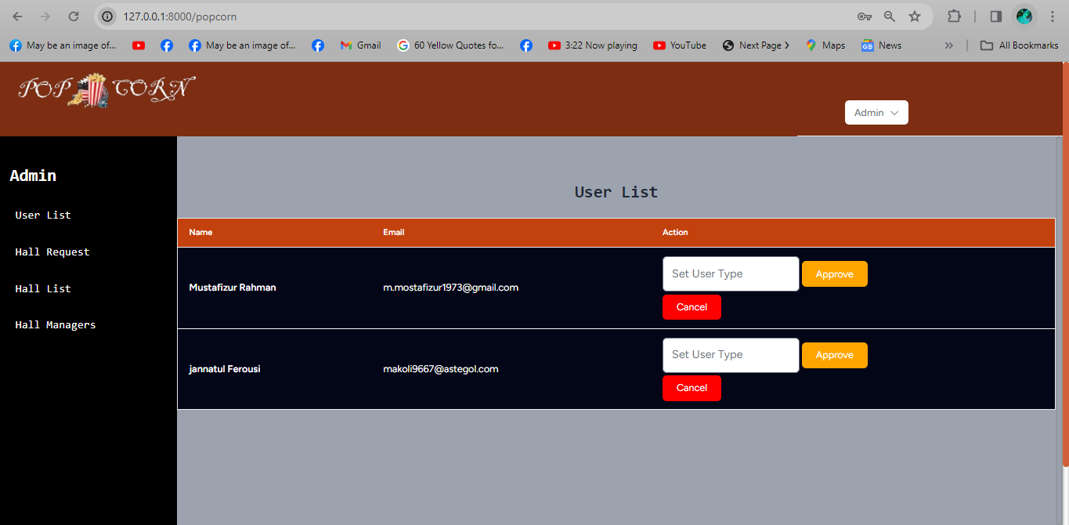
Admin Profile
Notes:
Dubai Futures Foundation:
http://gulfnews.com/news/uae/government/huge-global-response-for-dubai-future-accelerators-programme-1.1880339

Slide 20
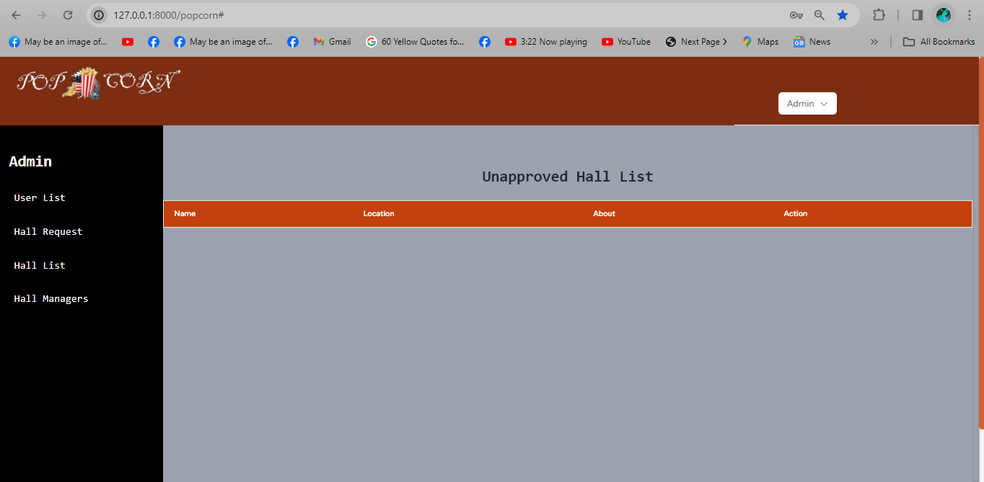
Admin Profile Continue…!
Notes:
Dubai Futures Foundation:
http://gulfnews.com/news/uae/government/huge-global-response-for-dubai-future-accelerators-programme-1.1880339

Slide 21
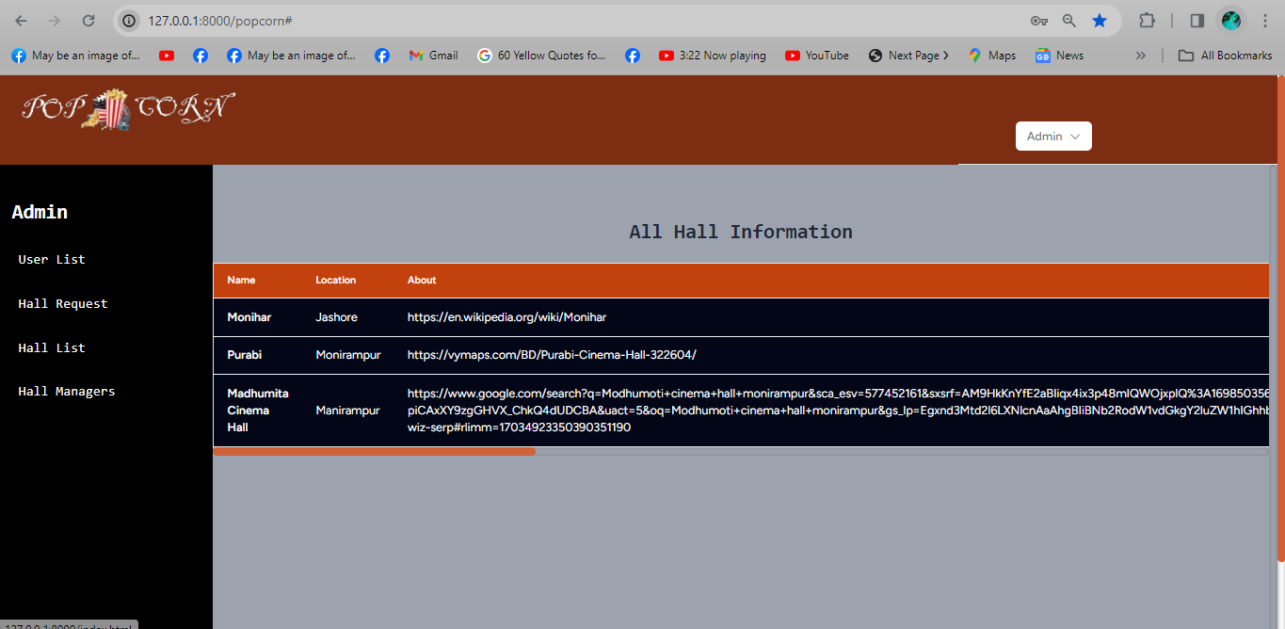
Admin Profile Continue…!!
Notes:
Dubai Futures Foundation:
http://gulfnews.com/news/uae/government/huge-global-response-for-dubai-future-accelerators-programme-1.1880339

Slide 22
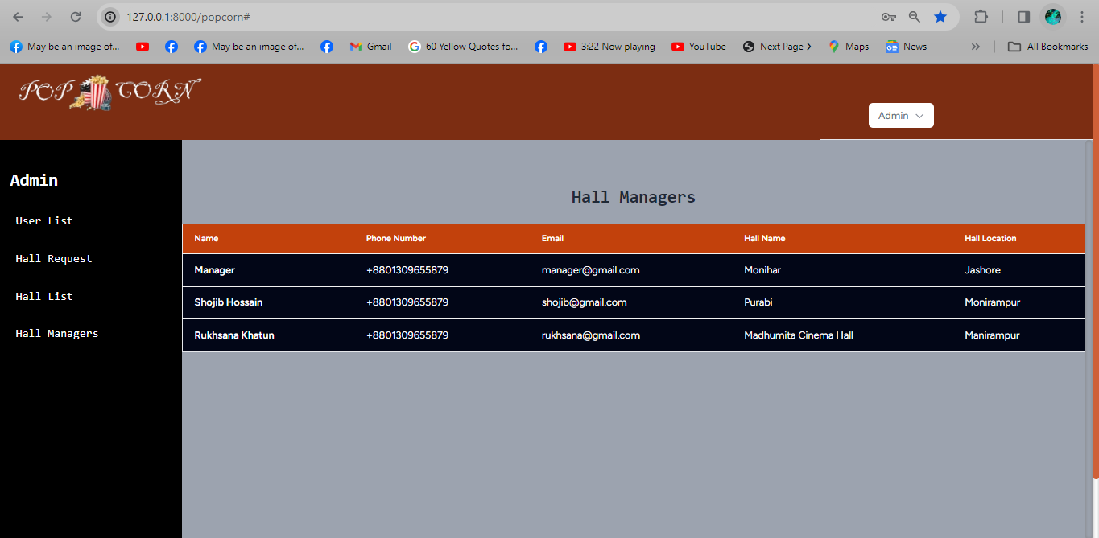
Admin Profile Continue…!!!
Notes:
Dubai Futures Foundation:
http://gulfnews.com/news/uae/government/huge-global-response-for-dubai-future-accelerators-programme-1.1880339

Slide 23
Summary
The "Popcorn" Online Movie Ticket Booking website offers a seamless cinema experience. With a user-friendly interface, users can effortlessly browse movies, purchase tickets securely, and manage profiles.
User:
Users of the "Popcorn" platform enjoy a seamless experience with the ability to browse movies, purchase tickets securely, and manage their profiles. The system caters to their preferences, providing an intuitive interface for a hassle-free movie ticket booking process.
Hall Manager:
Hall managers wield control over specific cinema halls, leveraging tools to update movie details, set prices, and manage operational aspects. This role empowers them to enhance the movie-going experience within their designated halls.
Admin:
Administrators hold the reins of the entire system, overseeing all halls and operations. They have the authority to approve hall manager requests, ensuring smooth functionality and a cohesive, well-managed online movie ticket booking platform.

Slide 24
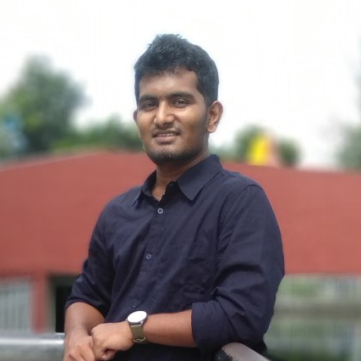
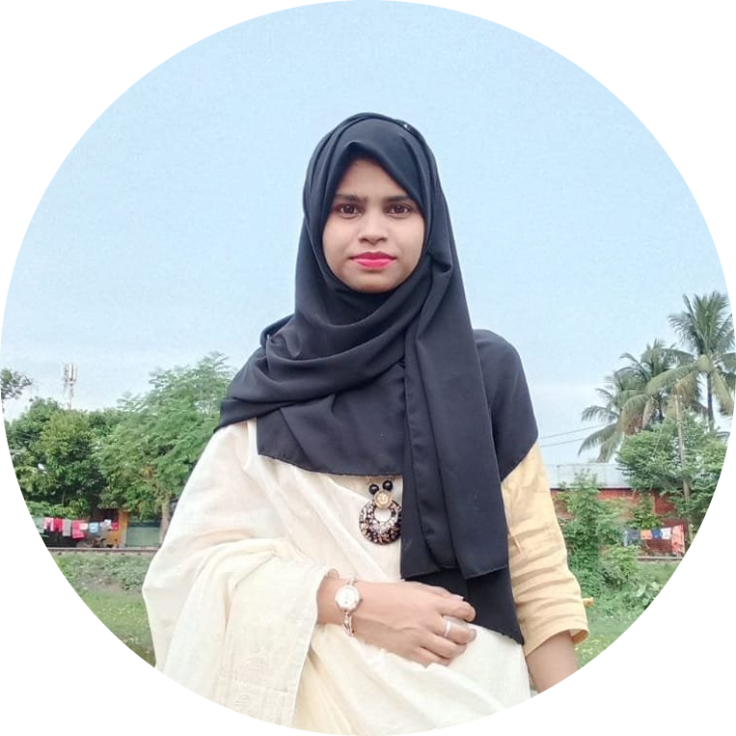
Team
Md Shojib Hossain
ID: 190103
Rukhsana Khatun
ID: 190148

Slide 25


